Slide 1
Operating System Overview
Da-Wei Chang
CSIE.NCKU
Source: Abraham Silberschatz, Peter B. Galvin, and Greg Gagne, "Operating System Concepts", 9th Edition, Wiley.

Slide 2
What is an Operating System?
A program that acts as an intermediary between user programs/applications and the computer hardware
Operating system goals
  Execute user programs
  Manage hardware (HW) resources
    User programs don’t have to deal with the HW directly
    OS ensures efficient resource sharing

Slide 3

Four Components of a
Computer System

Slide 4

Computer System Organization
Computer-system operation
  One or more CPUs, device controllers connect through common bus providing access to shared memory
  Concurrent execution of CPUs and devices
    CPU executes prog. A, while disk reading data required prog. B

Slide 5
Operating System Operations
An OS must prevent processes from modifying the operating system
Dual-mode operation allows OS to protect itself
  User mode and kernel mode
    User processes run in user mode (non-privileged mode)
    OS runs in kernel mode (privileged mode)
  Mode bit provided by hardware
    Provides ability to distinguish when system is running user code or kernel code
    Some instructions designated as privileged, only executable in kernel mode
    A system call changes to the kernel mode, return from the call resets the mode to user

Slide 6

Transition from User to
Kernel Mode
At system boot time, the HW starts in the kernel mode.
- after system initialization, the OS run applications in user mode.
When a user process needs an OS service, it issues an system call
e.g., read a file, send a packet…
System call flow---

Slide 7
Transition from User to
Kernel Mode
Modes are provided by HW
  Intel’s 8088 CPU has only a single mode
    The OS (e.g., MS-DOS) can be crashed by a user program
  Modern x86 has (more than) 4 modes/rings

Slide 8
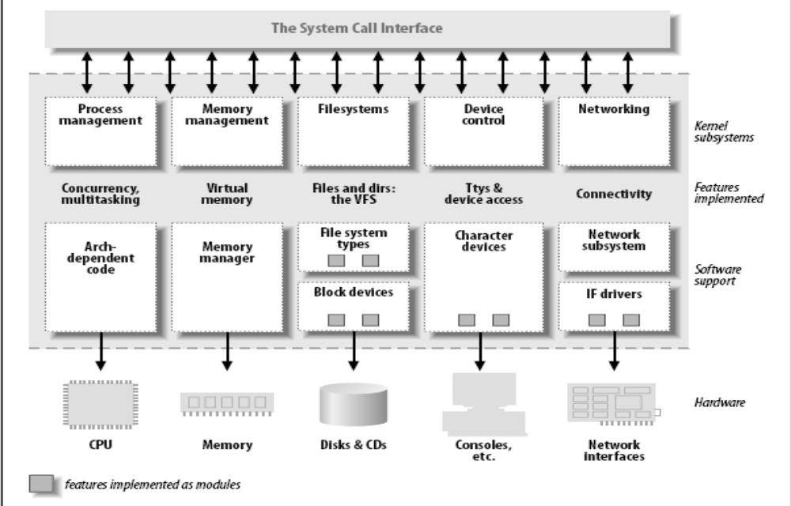
Inside an OS Kernel

Slide 9
Ref: Process Management
A process is a program in execution. It is a unit of work within the system. Program is a passive entity, process is an active entity.
Process needs resources to accomplish its task
  CPU, memory, I/O, files
  Input data
    E.g. the name of the file that needs to be displayed
Process termination requires reclaiming reusable resources
Single-threaded process has one program counter specifying location of next instruction to execute
  Process executes instructions sequentially, one at a time, until completion
Multi-threaded process has one program counter per thread
Typically, a system has many processes running concurrently on one or more CPUs
  Concurrency by multiplexing the CPUs among the processes / threads

Slide 10
Ref: Process Management Activities
The operating system is responsible for the following activities related to process management
  Creating and deleting processes
  Suspending and resuming processes
  Providing mechanisms for process synchronization
  Providing mechanisms for process communication
  Providing mechanisms for deadlock handling

Slide 11
Ref: Memory Management
Data have to be put in memory before being processed
Instructions have to be put in memory before being executed
Memory management determines what is in memory
  Goal: optimizing CPU utilization and computer’s response to users
Memory management activities
  Keeping track of which parts of memory are currently being used and by whom
  Deciding which processes (or parts thereof) and data to move into and out of memory
  Allocating and deallocating memory space as needed

